Slide 1
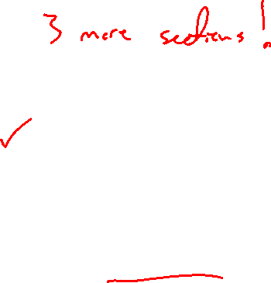
Section 11.8 Power Series
Lecture 1
Foundation

Slide 2

Section Homework Submission to Canvas
Preview of section​
Skim section, write short paragraph summary, list all important definitions / theorems / formulas.​
Notes on video lectures​
Include all details, worked examples, your own thoughts​
Worked examples from text​
Solutions to exercises​
Final reflection of section​
List of key takeaways to remember​

Slide 3
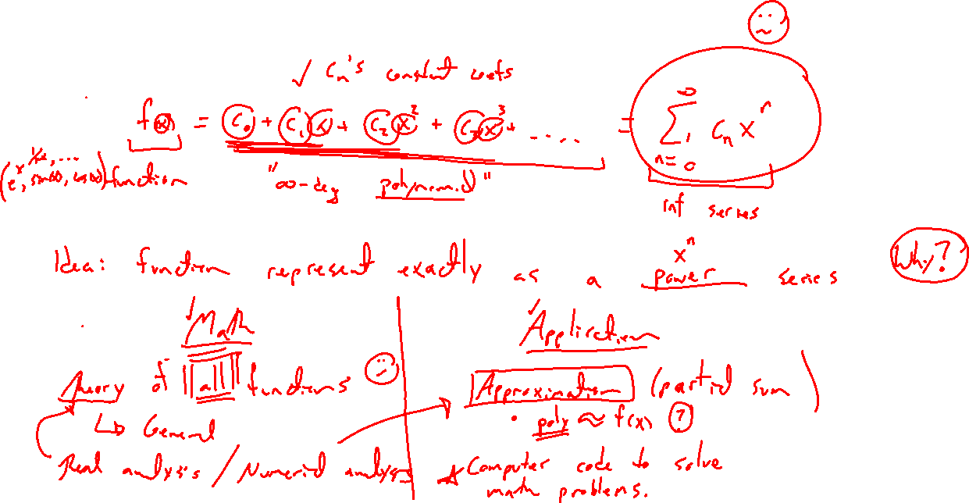
Power Series Motivation
Notes:
f(x) = c_0 + c_1 x + c_2 x^2 + ….
Math: Theory of functions
Applications: Approximation and numerical methods

Slide 4
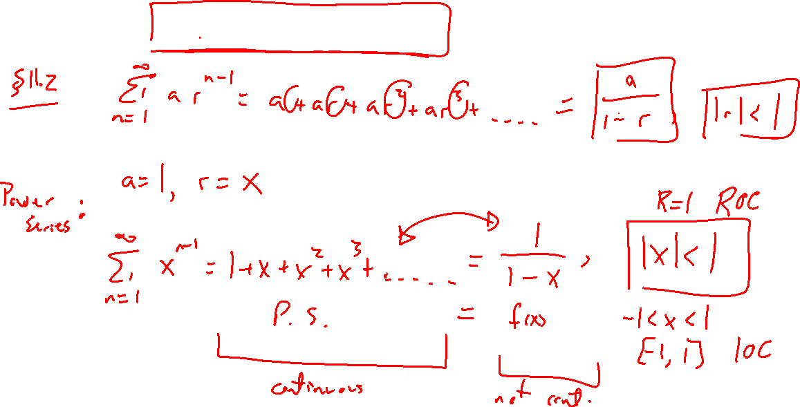
Example: Geometric Series
Notes:
Old definition
A=1, r = x gives 1/(1-x) = …. |x|<1
Desmos demonstration

Slide 5
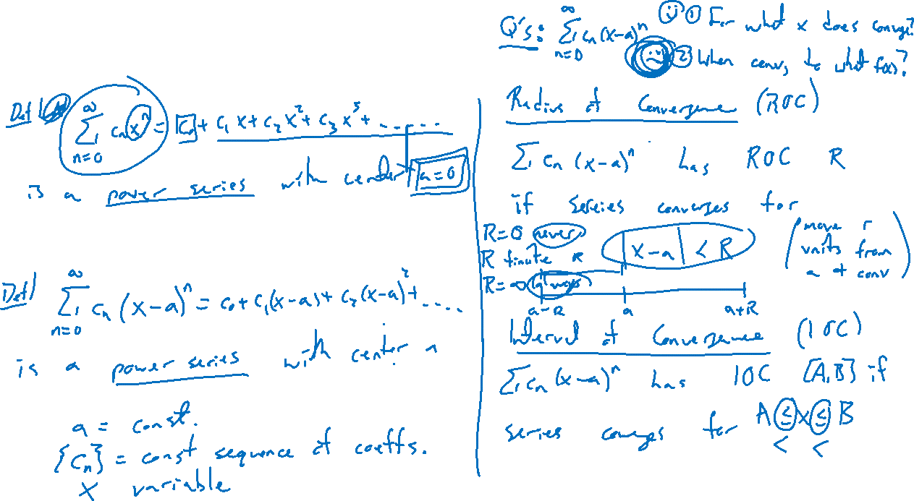
Power Series Definition
Notes:
Center at 0, general a
Radius of convergence
Interval of convergence
Connect to Geom series

Slide 6
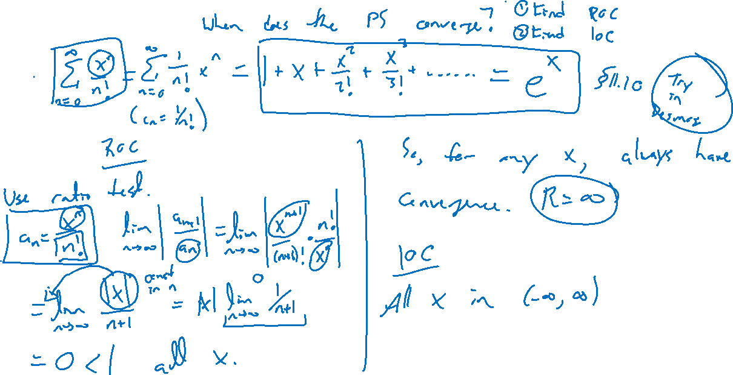
Example:
Notes:
Sum x^n / n!
Find the Radius and Interval of Convergence

Slide 7
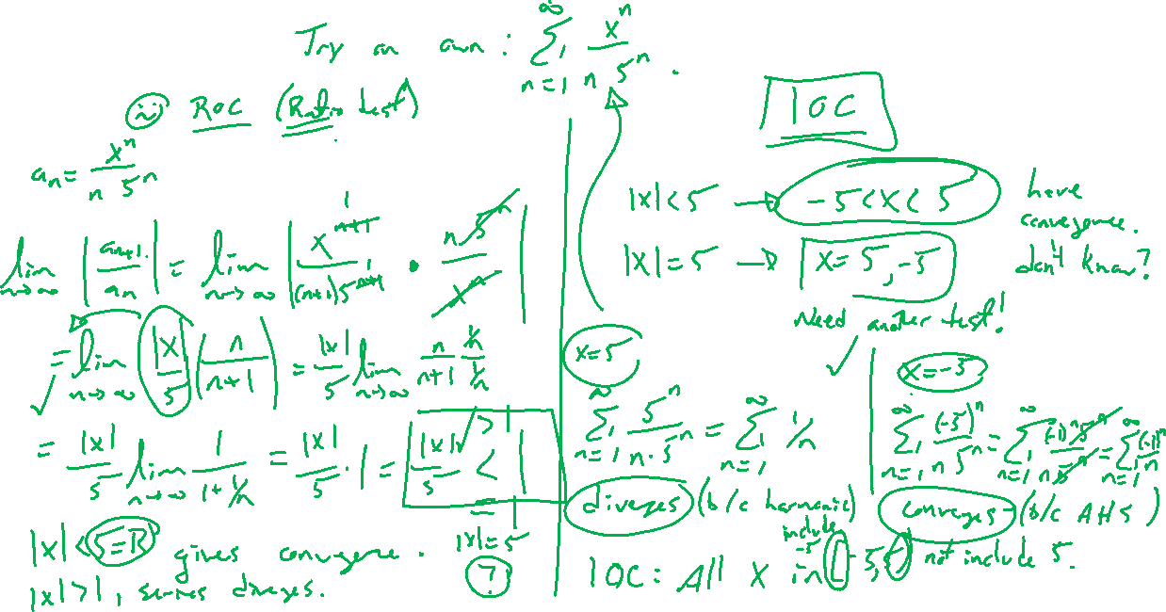
Example
Notes:
Find the Radius and Interval of Convergence
Sum x^n / (n 5^n)

Slide 8
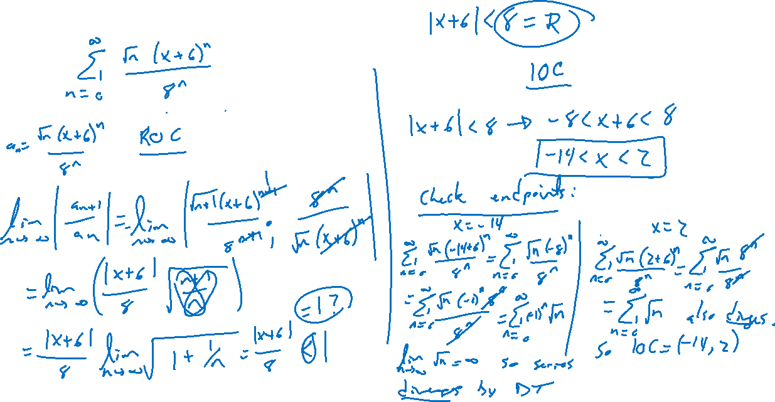
Example: Try on Own
Notes:
Sum sqrt{n}(x+6)^n / 8^n
Note the center has moved

Slide 9
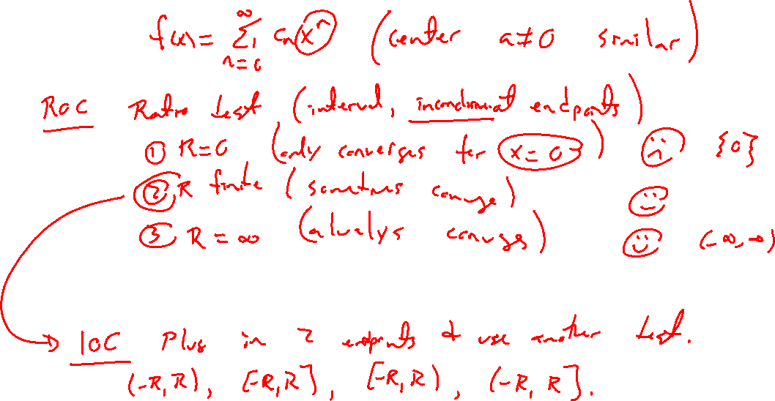
Summary of ROC and IOC Cases

Slide 10

Section 11.8 Examples and Homework
Rework textbook examples: 1, 2, 4, 5
Write down problem.
Close book and attempt on own.
Compare your solution to text solution, improve your writing.
Exercises: 3, 5, 11, 17, 23

Slide 11

Section Homework Submission to Canvas
Preview of section​
Skim section, write short paragraph summary, list all important definitions / theorems / formulas.​
Notes on video lectures​
Include all details, worked examples, your own thoughts​
Worked examples from text​
Solutions to exercises​
Final reflection of section​
List of key takeaways to remember​

